Slide 1
Blockchain & Legal Innovation I Tutorial – Smart Contracts

Slide 2
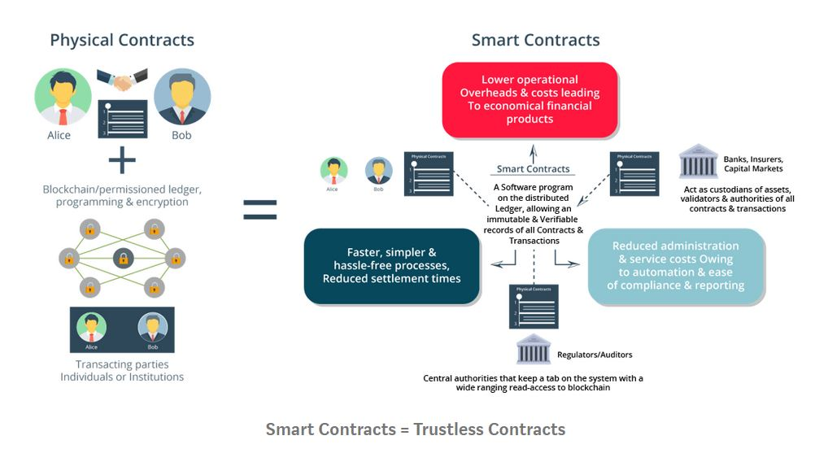
The Promise of Smart Contracts
https://medium.com/@teexofficial/what-are-oracles-smart-contracts-the-oracle-problem-911f16821b53

Slide 3
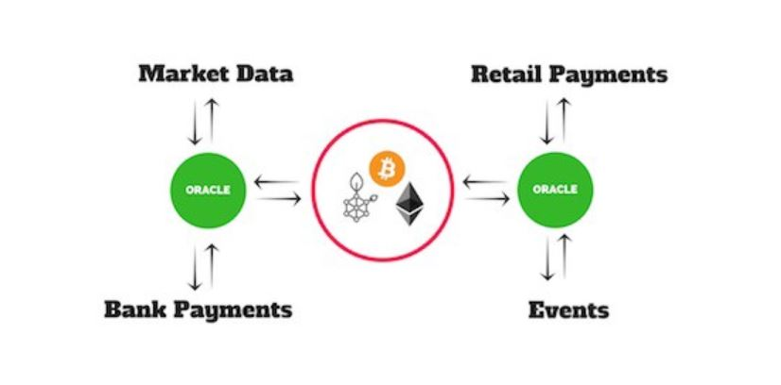
Smart Contracts Need Oracles

Slide 4
Types of Oracles
Hardware Oracles are sensors integrated with tangible physical objects. Primary examples would be in supply chain tracking with the use of RFID tags for feeding data like environmental conditions of products to the blockchain.
Software Oracles are the most common form that pull data from third-party sources such as web APIs and can include real-world information like flight statuses and weather data.
Consensus Oracles represent a step towards decentralized oracles and rely on aggregating data from several oracles with proprietary methods for determining their authenticity and accuracy.
Inbound Oracles reflect “if this happens then do that” scenarios associated with software oracles such as “if this price is met by an asset, then trigger a sell.”
Outbound Oracles allow smart contracts to send data to sources outside of the blockchain network they exist on and are also software oracles.

Slide 5
The Oracle Problem
The oracle becomes a means of attacking the smart contract.
It is a “trusted third party” and trusted third parties are security holes and lawyer magnets.

Slide 6
Discussion Question
Should Oracles have fiduciary duties?

Slide 7
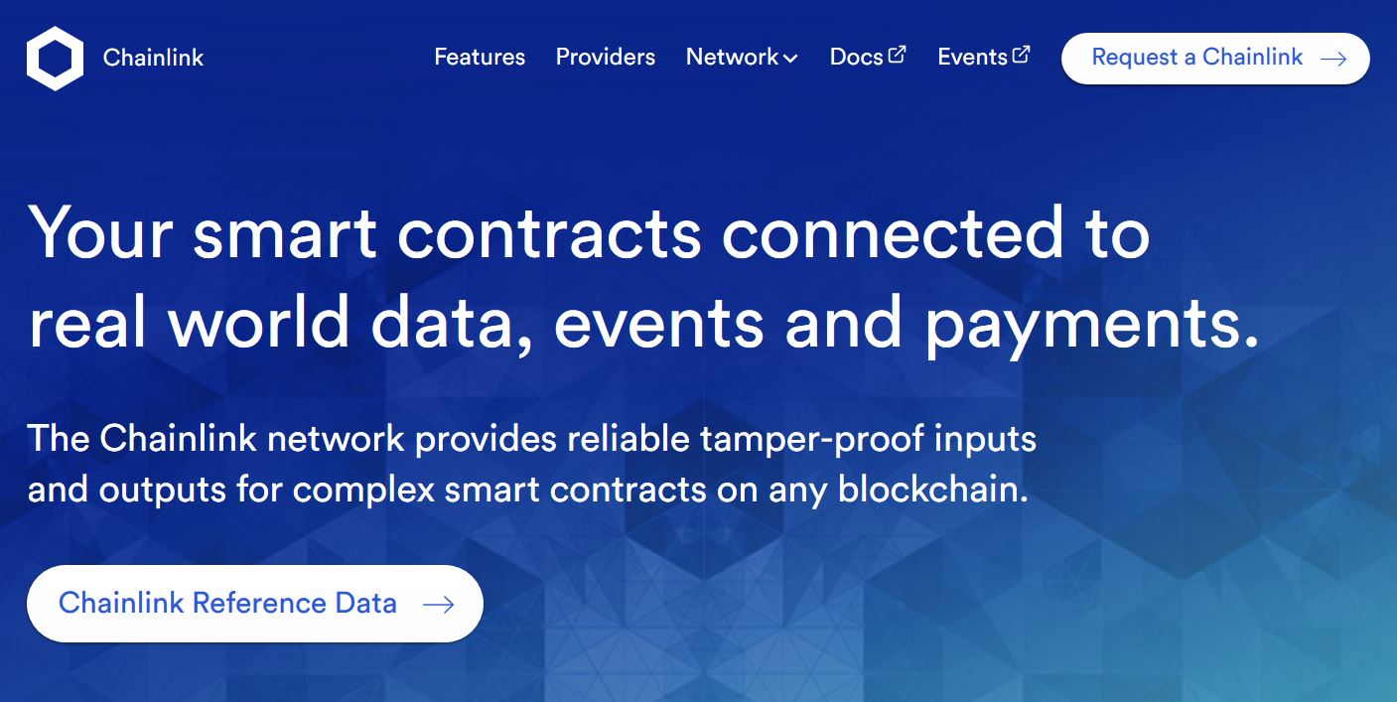
Chainlink – Decentralised Oracle

Slide 8
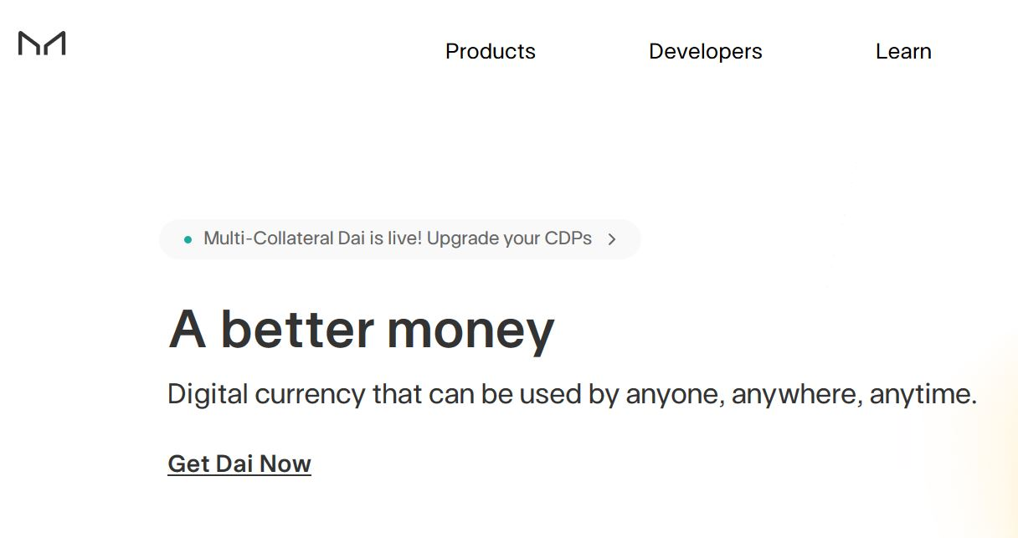
Dynamically Pegged Stablecoins
Step​ ​1:​ Create and ​Collateralize a Vault
A user creates a Vault… by funding it with a specific type and amount of collateral that will be used to generate Dai. Once funded, a Vault is considered collateralized.
Step​ ​2:​ ​Generate Dai​ ​from​ ​the​ ​Collateralized​ ​Vault
The Vault owner initiates and confirms a transaction in her unhosted cryptocurrency wallet in order to generate a specific amount of Dai in exchange for keeping her collateral locked in the Vault.
Step​ ​3:​ ​Pay Down​ ​the​ ​Debt​ ​and​ the Stability​ ​Fee
To retrieve a portion or all of the collateral, a Vault owner must pay down or completely pay back the Dai she generated, plus the Stability Fee that continuously accrues on the Dai outstanding. The Stability Fee can only be paid in Dai.
Step​ ​4:​ ​Withdraw Collateral
With the Dai returned and the Stability Fee paid, the Vault owner can withdraw all or some of her collateral back to her wallet. Once all Dai is completely returned and all collateral is retrieved, the Vault remains empty until the owner chooses to make another deposit

Slide 9
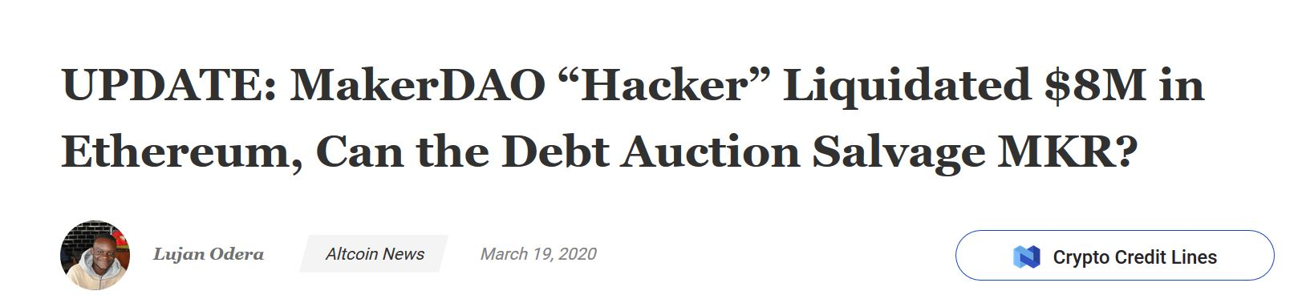
But…
https://coingape.com/makerda-hacker-liquidated-8m-ethereum/

Slide 10
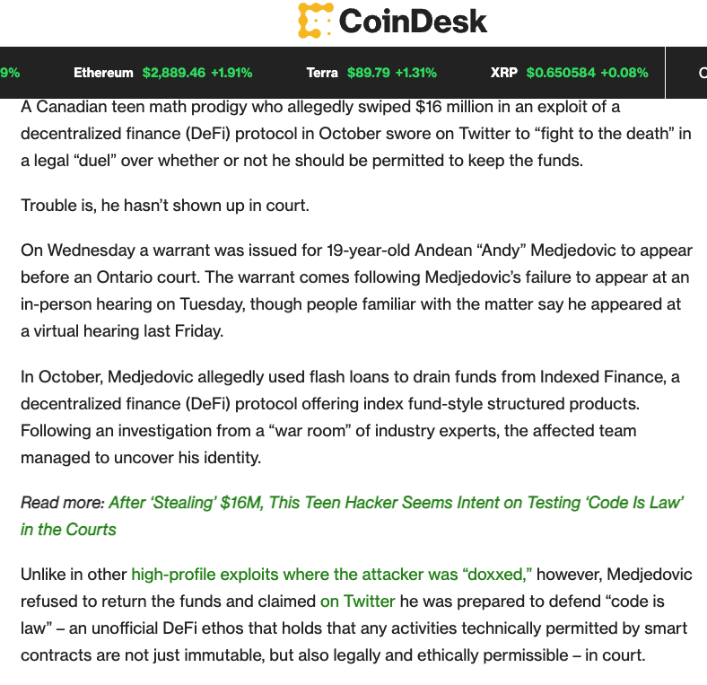
And also…
https://www.coindesk.com/policy/2021/12/22/teenage-suspect-in-16m-defi-hack-wanted-for-arrest-in-canada/

Slide 11
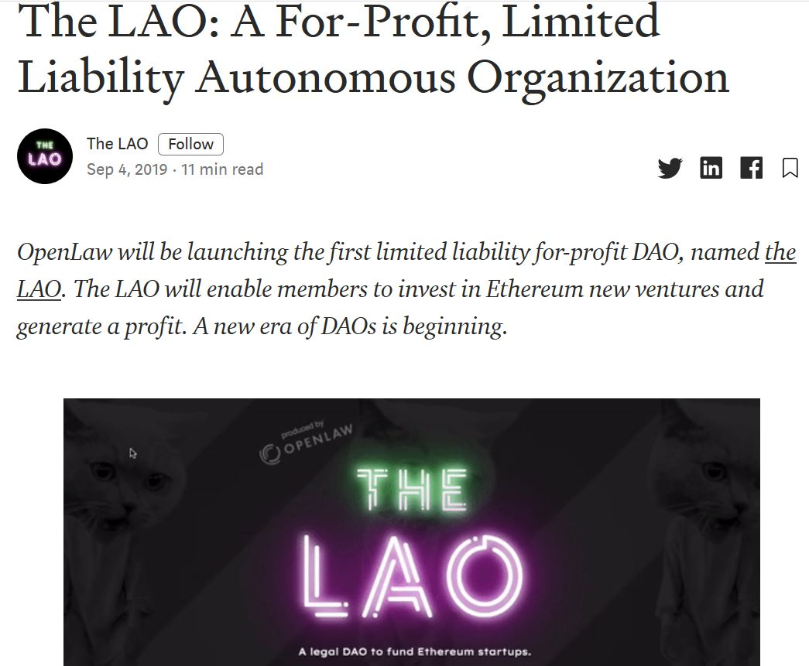
Legal Autonomous Organisations
Purpose: A legal structure to enable members to invest in blockchain-based projects in exchange for tokenized stock or utility tokens.
Structure: A limited liability entity, organized in Delaware, using curated smart contracts to handle mechanics related to voting, funding, and allocation of collected funds. Members will be able to purchase interests in the LAO and the proceeds from the purchase will be pooled and allocated by members to startups and other projects in need of financing, using a voting mechanism. And, the LAO will be anchored by 10 founding members.
Desired Effect: Limit the liability of LAO members and avoid knotty questions related as to whether partnership law applies. Clarify tax flow — through treatment by the Internal Revenue Service, such that tax is not paid by both the entity and a person holding a beneficial interest in the LAO.
Accredited Investors Only: Only available to parties that meet the definition of an accredited investor — although there are arguments that LAO membership interests may not be securities.(!!!)
https://medium.com/openlawofficial/the-lao-a-for-profit-limited-liability-autonomous-organization-9eae89c9669c

Slide 12
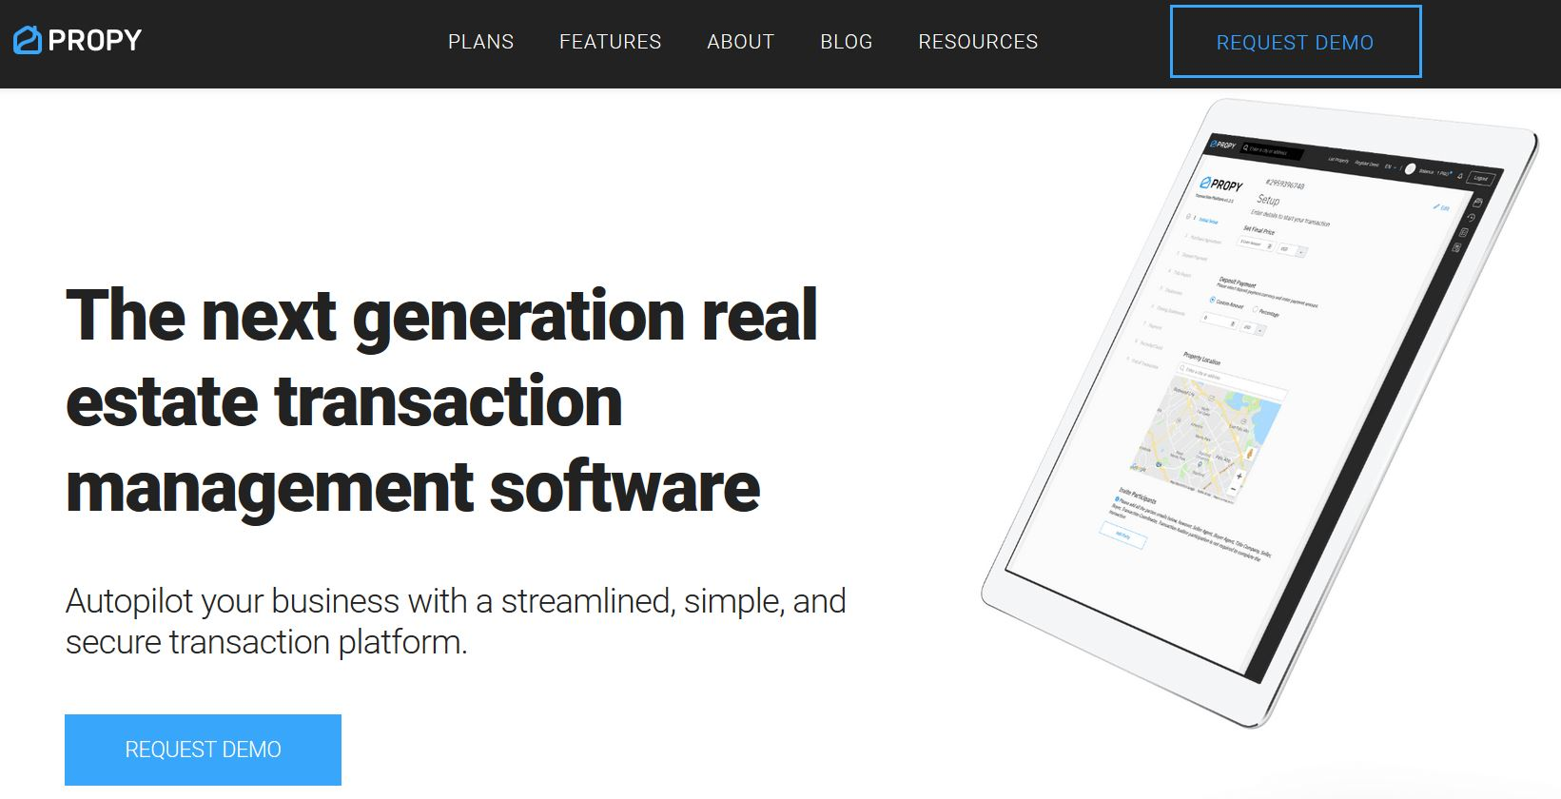
Real Estate on Blockchain

Slide 13
Propy – Real Estate on Blockchain
Step 1: Property Choice
Go on Propy, select your desired property, choose an agent, and make an offer.
Step 2: Purchase and Sale Agreement
Propy automatically generates the purchase and sale agreement, and it performs ownership verification through a third party. The Offer gets signed electronically by all participants. Once all parties provide their signatures, the purchase agreement gets encrypted, and it is recorded on the blockchain.
Step 3: Additional Documents The title agent uploads the title report so that both the buyer and the seller can sign it online. The seller’s agent uploads disclosure documents so that the participants can sign them. The title agent uploads separate estimates, called the Settlement Statements, to the buyer and the seller. After both parties sign them, the title agent provides an escrow bank account, thus avoiding the risk of e-mail and wire fraud.
Step 4: Payment The buyer has fiat and cryptocurrency options for payment. After the payment form is automatically generated and the amount is processed, Propy marks the payment as received on the smart contract.
Step 5. Deed
At this final step, the buyer receives the officially recorded deed with the blockchain address on it. The records are kept at the municipality and on the blockchain. Because the deed is recorded on the blockchain, the buyer has an unhackable proof of ownership.
Since everything is recorded on the blockchain, there is no opportunity for fraudulent behavior in the transaction process. Additionally, with Propy’s automation features, sellers and buyers save money on fees.
https://propy.com/blog/what-is-propy-how-does-propy-work/

Slide 14
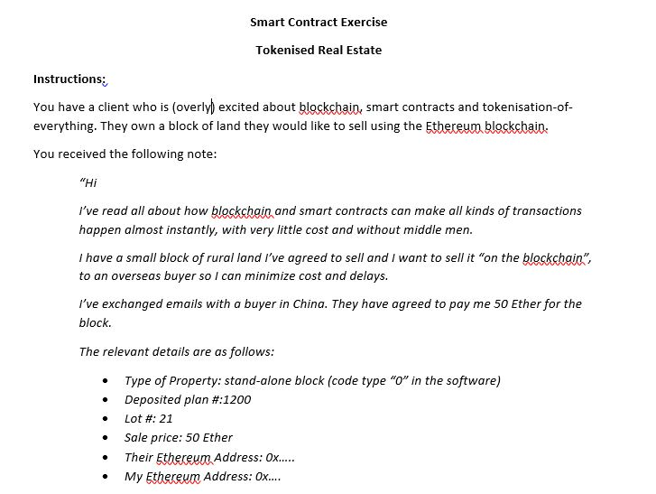
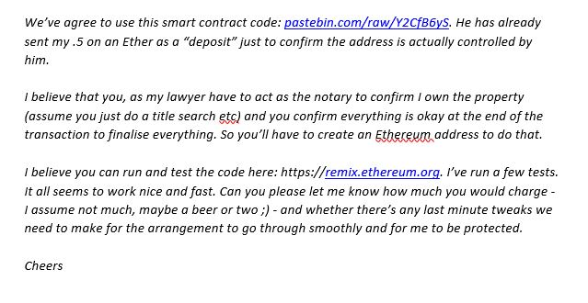
The Smart Contract Assignment – Initial Instructions

Slide 15
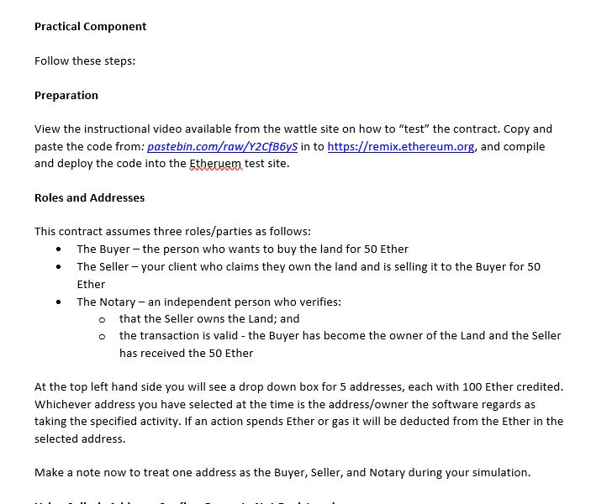
Practical Component
Be sure to review the instructional demo video uploaded to wattle.
Note: If you find this challenging reflect on how difficult it is as a client to understand (and rely upon) these systems for doing transactions.

Slide 16
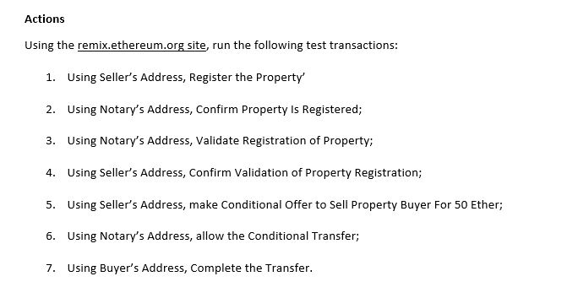
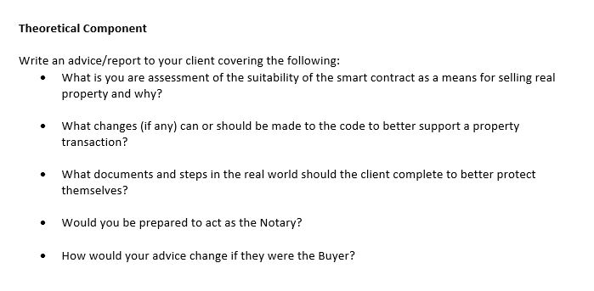
Smart Contract Assessment

Slide 17
Smart Contract Queries?
Post to technical discussion board so I can help answer them.

